Slide 1




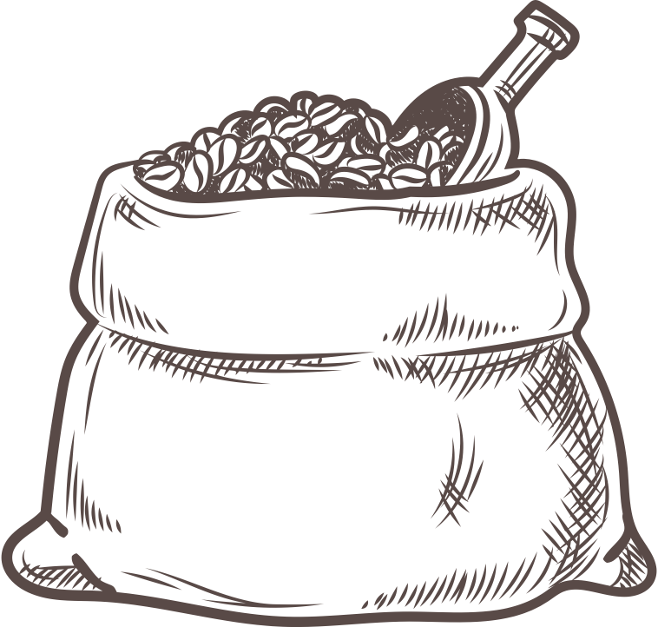
ALY6030 - Final Project
Coffee Chain Sales Analysis
BY- KUAN-YU CHI (KEN) & BHAGYASHRI KADAM (BK)
PROFESSOR – VENKATA DUVVURI
DATE – 13th Dec 2023

Slide 2


PROJECT WORKFLOW
Dataset Introduction
Schema Creation
Normalization
Dimensional Modeling
Analytics & Reporting
Conclusion/Insights

Slide 3


INTRODUCTION
The Coffee Chain Sales data provides valuable insights into the performance of a coffee chain across various locations in the US
Data
Data Source
1063 records & 21 attributes
Kaggle
Skills Enforced
Tools Used
Dimensional Modeling,
Normalization
Table Creation & Exploration
BIG 6 – SQL & JOINS

Slide 4
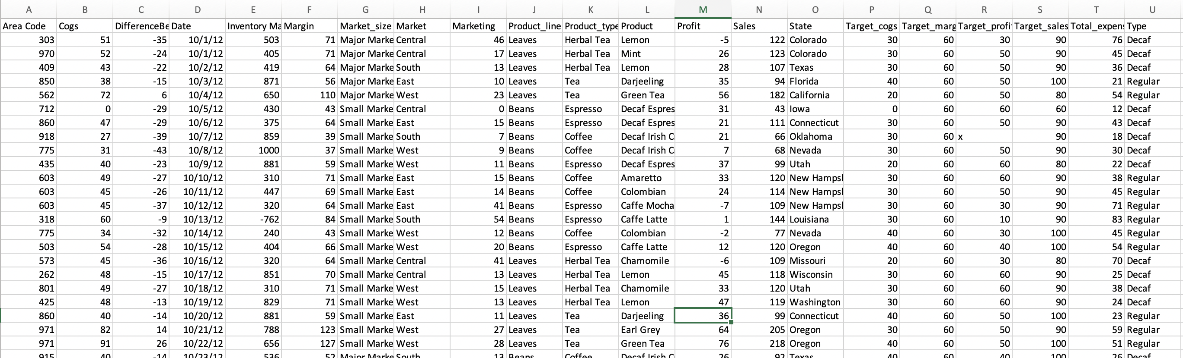
Original Data

Slide 5
KEY ATTRIBUTES
1. Area Code: A unique identifier for different geographical areas or regions where the coffee chain operates.
2. COGS (Cost of Goods Sold): The total cost incurred by the coffee chain in producing or purchasing the products it sells.
3. Difference between Actual and Target Profit: This attribute indicates how well the company performed in terms of profit compared to its target. It reflects the financial performance against predefined goals.
4. Date: The date of sales transactions, which allows for time-based analysis of sales trends and patterns.
5. Inventory Margin: The difference between the cost of maintaining inventory and the revenue generated from selling those inventory items.
6. Margin: The profit margin, which is the percentage of profit earned from sales. It’s a critical financial metric.
7. Market Size: Information about the size of the market in each area to understand the potential customer base.
8. Profit: financial gain achieved by the company after deducting the cost of goods sold (COGS) and other expenses from the revenue generated through sales.
9. Sales: Revenue generated from the coffee chain's products, reflecting its financial performance and customer demand.
10. Product Line: The category of the product within the product type.
11. Product Type: The Type of product being sold.
12. State: The geographical state of operations.
13. Target_cogs, Target_margin, Target_profit, Target_sales: Target metrics for comparison.

Slide 6
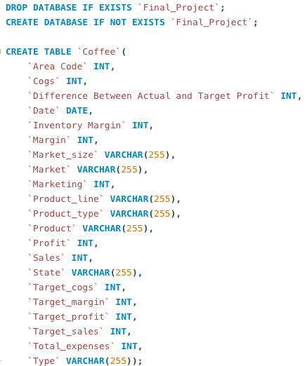
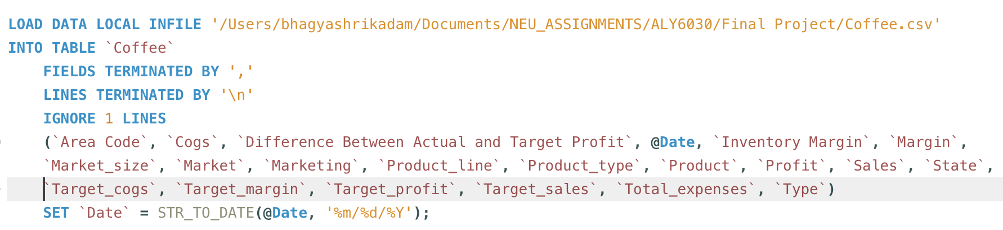
SCHEMA CREATION
Creating DB – Final_Project &
Main Table - Coffee
Loading Data
1.
2.

Slide 7
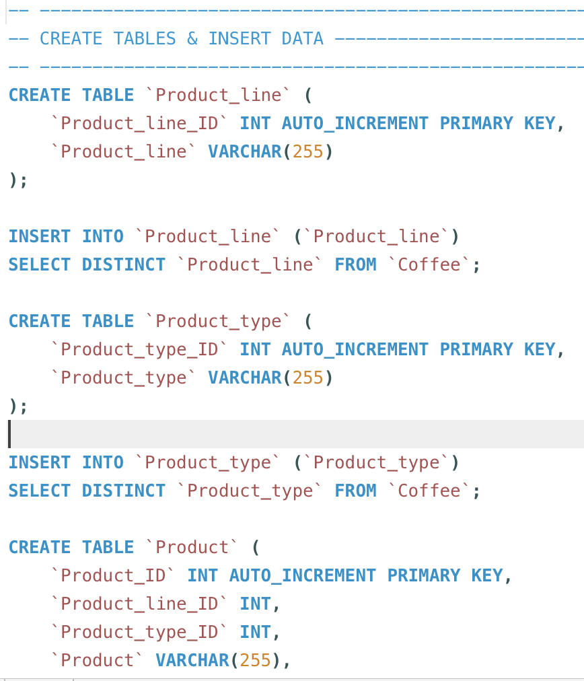
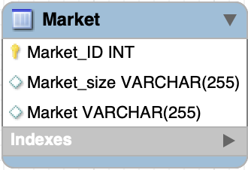
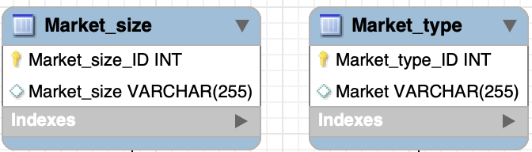
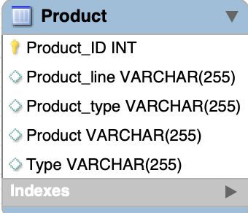
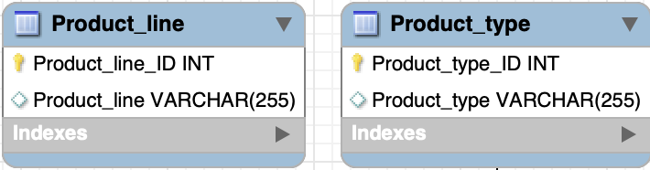
NORMALIZATION
Converted the Raw data into a set of relational tables that meet the 3NF standards by creating SQL queries in MySQL.

Slide 8



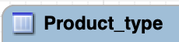
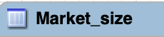




NORMALIZATION
Final Tables after 3NF Normalization
FACT TABLES
DIMENSION TABLES

Slide 9
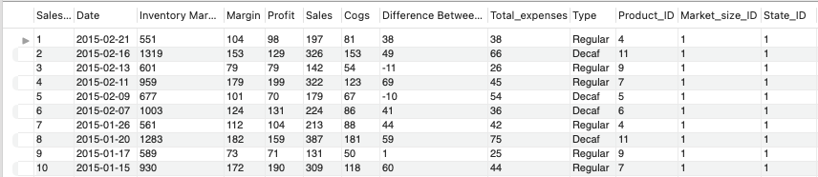
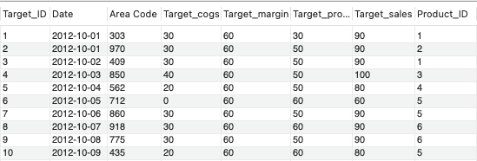
NORMALIZATION – Fact Tables
Final Tables after 3NF Normalization
FACT TABLES

Slide 10
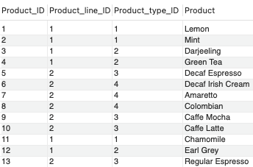
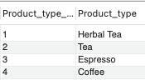
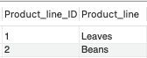
NORMALIZATION – Dimension Tables
Final Tables after 3NF Normalization
DIMENSION TABLES

Slide 11
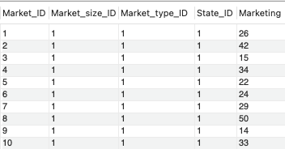
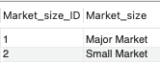
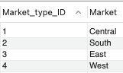
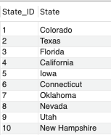
NORMALIZATION – Dimension Tables
Final Tables after 3NF Normalization
DIMENSION TABLES

Slide 12
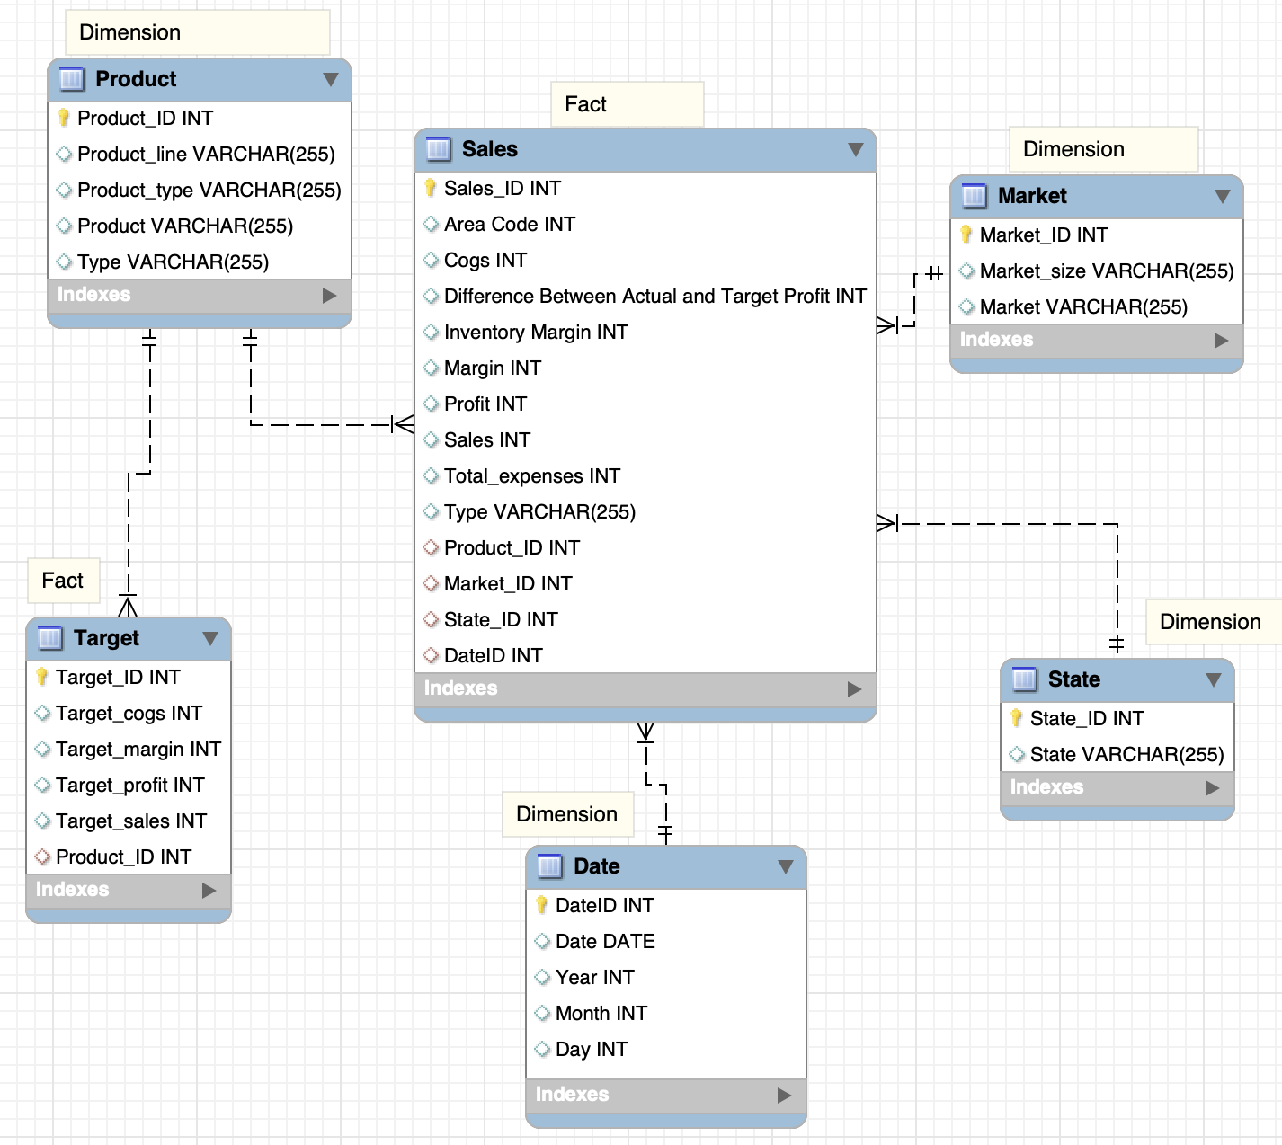

Dimensional Modeling- Star Schema
Facts : Sales , Target
Dimension : Product , Market ,
State , Date
Disadvantages / Challenges :
Data Redundancy
Query Complexity
Maintenance Overhead
Performance issues

Slide 13
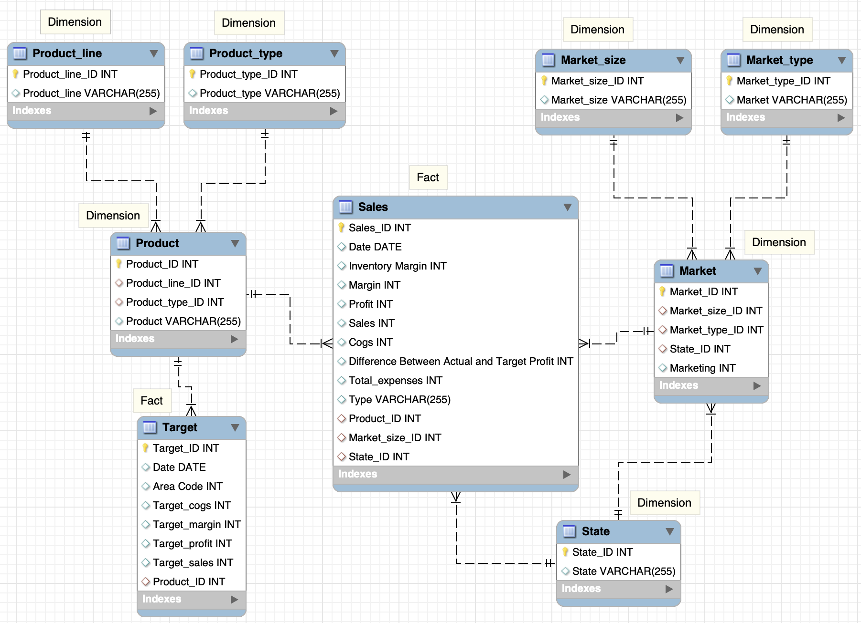
Dimensional Modeling- Snowflake Schema
Facts : Sales , Target
Dimension : Product line ,
Product type , Product ,
Market_size , Market_type ,
Market & State
Advantages :
Normalization
Easier to Update
Improved Data Integrity
Efficient Query Performance

Slide 14

ANALYTICS & REPORTING

Slide 15
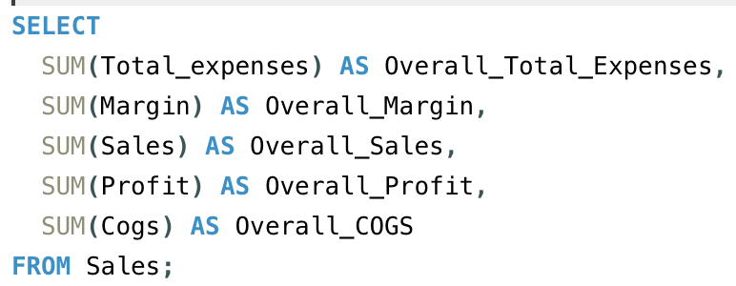
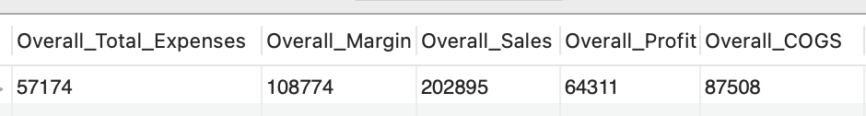
KEY PERFORMANCE INDICATORS
KPIs : Overall Total Expenses , Margin , Sales , Profit & Cost of Goods Sold (COGS)

Slide 16
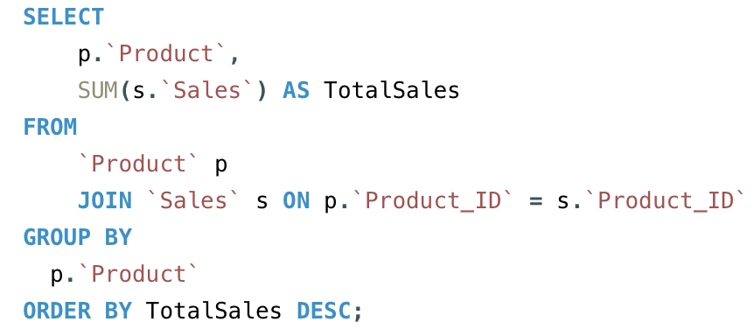
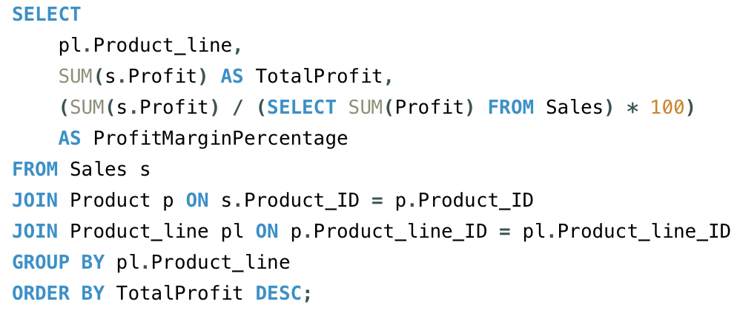
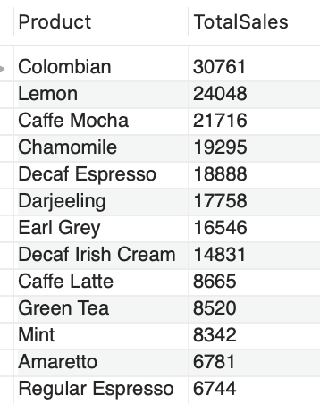
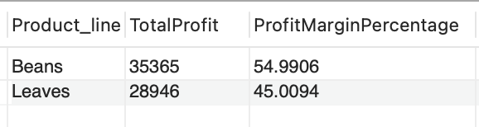
BUSINESS QUERIES - PRODUCTS
Product Line Performance: How does each product line contribute to the overall profit margin?
Product Sales Performance : Which are the best performing products based on Sales revenue ?

Slide 17
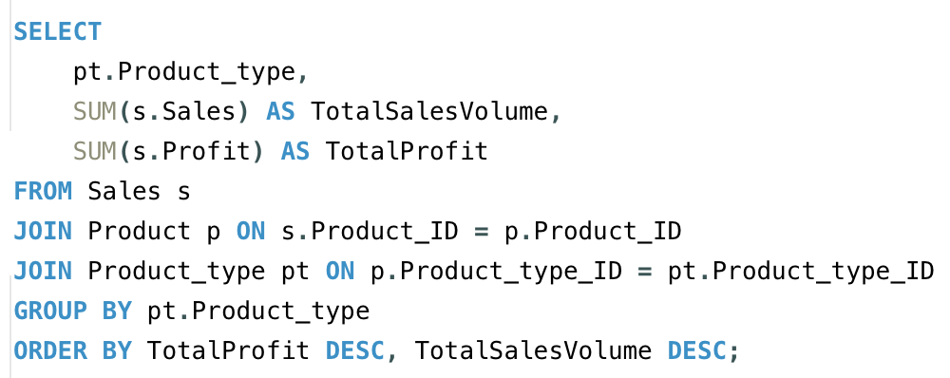
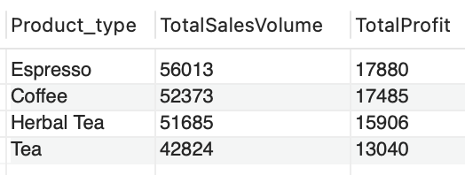
BUSINESS QUERIES - PRODUCTS
3. Which product types are the most profitable, and which are the most popular based on sales volume?

Slide 18
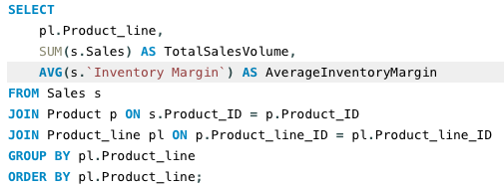
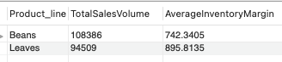
INVENTORY
Inventory and Sales Correlation: Is there a correlation between inventory margin and sales volume in different product lines?

Slide 19
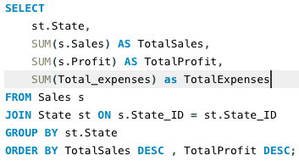
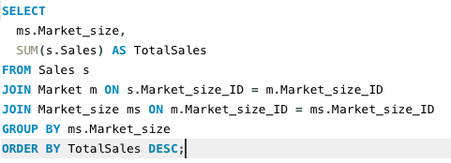
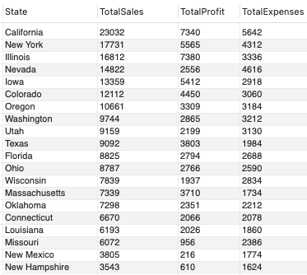
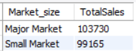
LET’s TALK SALES !
State Sales Comparison & Performance: Which states has the highest contribution to Sales & Profit and how do their expenses compare to Sales?
Market Analysis: How do sales volumes vary across different market sizes?

Slide 20
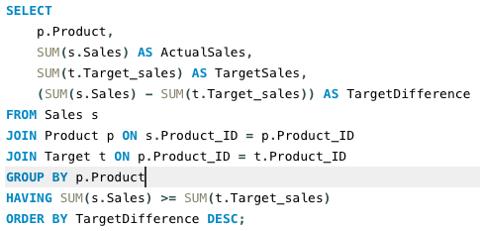
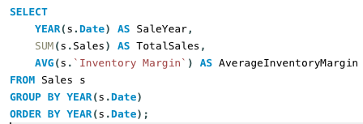
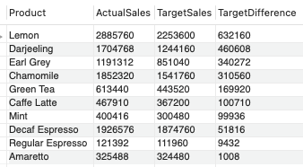
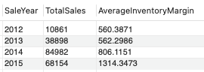
LET’s TALK SALES !
Target Sales Achievement: Which products are consistently meeting or exceeding sales targets?
Seasonal Trends: Are there any seasonal patterns in sales over the years, and how do they align with inventory margins?

Slide 21
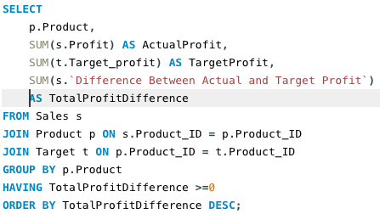
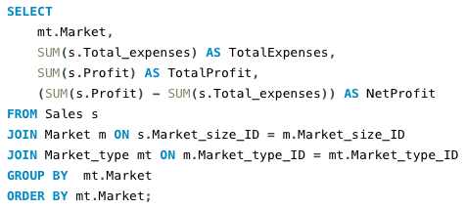
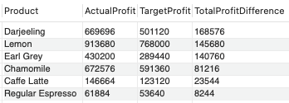
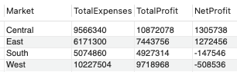
LET’s TALK PROFITS !
Target Profit Achievement: Which products are consistently meeting or exceeding profits?
Expense Management: How do total expenses relate to the overall profit in each market?

Slide 22
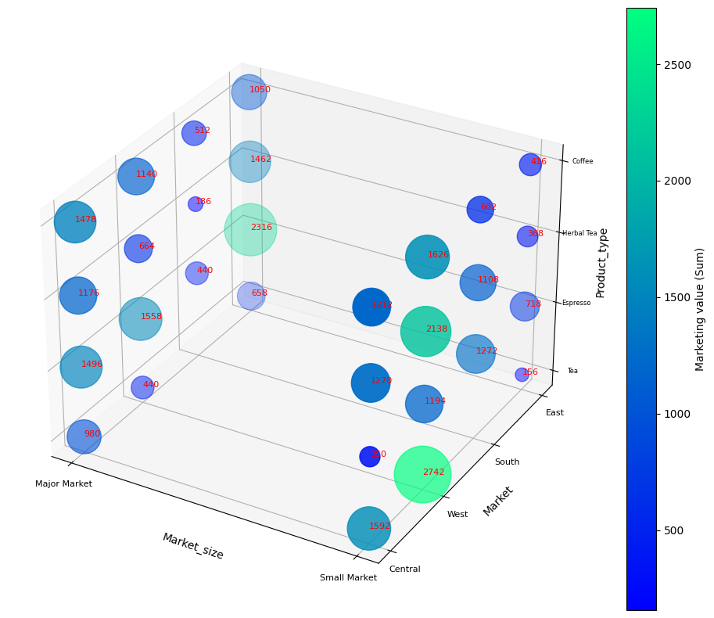
3D Dimension Cube – Marketing Analysis

Slide 23
CONCLUSION/INSIGHTS
Overall Business Insights:
Profitable Product Lines: Beans and Leaves are the most profitable product lines.
State-Level Performance: California leads in sales, while New York has the highest expenses.
Target Achievement: Lemon consistently exceeds sales targets.
Market Analysis: Major markets contribute significantly to overall sales.
Expense Management: East and Central markets are more profitable.
Recommendations:
Focus on High-Performing Products: Invest in marketing and promotion for top-selling products like Colombian and Lemon.
Expense Optimization: Explore cost-saving measures in markets with high expenses.
Target Refinement: Review and adjust sales targets based on product and market performance.
Next Steps:
Further Analysis: Conduct a deeper analysis of seasonal trends and inventory management.
Market Expansion: Explore opportunities for expansion in high-performing markets.
Target Review: Regularly review and adjust sales and profit targets based on market dynamics.

Slide 24

References
Kaggle Dataset Link : https://www.kaggle.com/datasets/amruthayenikonda/coffee-chain-sales-dataset/data

Slide 25


Thank You!

